Slide 1
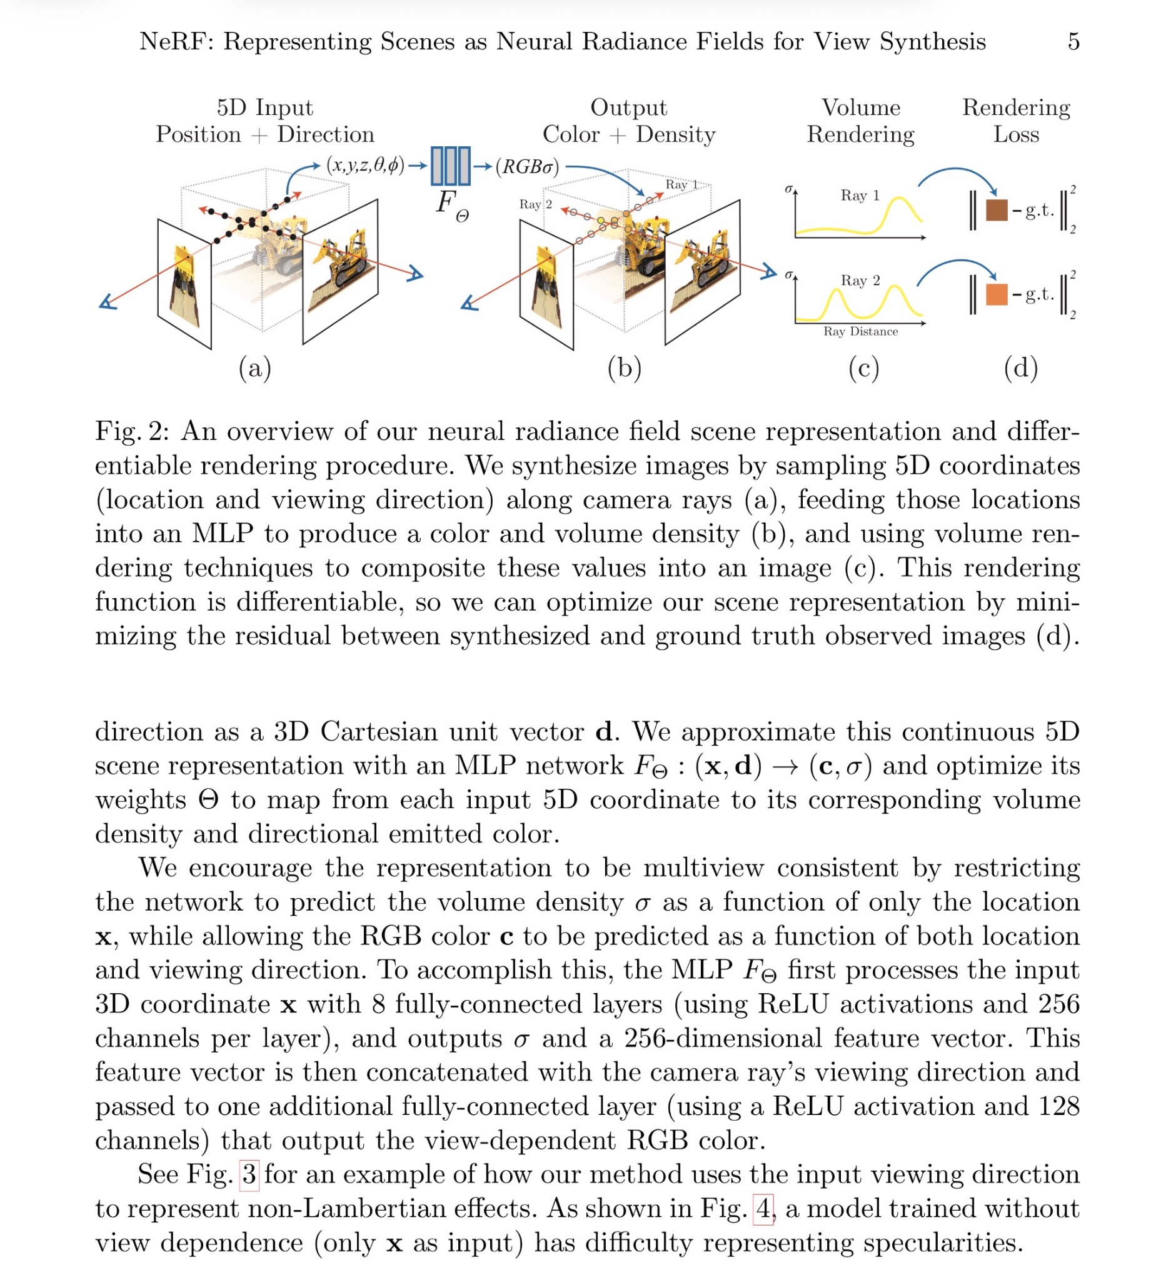
Danyal Khorami
HW0
Paper: NeRF: Representing Scenes as
Neural Radiance Fields for View Synthesis

Slide 2
Danyal Khorami
HW0
I chose NeRF (Neural Radiance Fields) because it represents a major moment when deep learning became part of the rendering method itself. Before NeRF, producing new views of a real scene usually meant building explicit 3D geometry (meshes/voxels) or relying on classic image-based rendering methods that struggled with complex lighting and view-dependent effects. NeRF introduced a new idea: instead of modeling the world with triangles, it learns a continuous “radiance field” function from photographs, so the scene exists as a neural network that can be queried along camera rays. This approach was groundbreaking because it combines ray-based rendering (volume integration along rays) with a learned scene representation, allowing photorealistic novel-view synthesis with accurate perspective and natural view-dependent appearance like specular highlights.

Slide 3
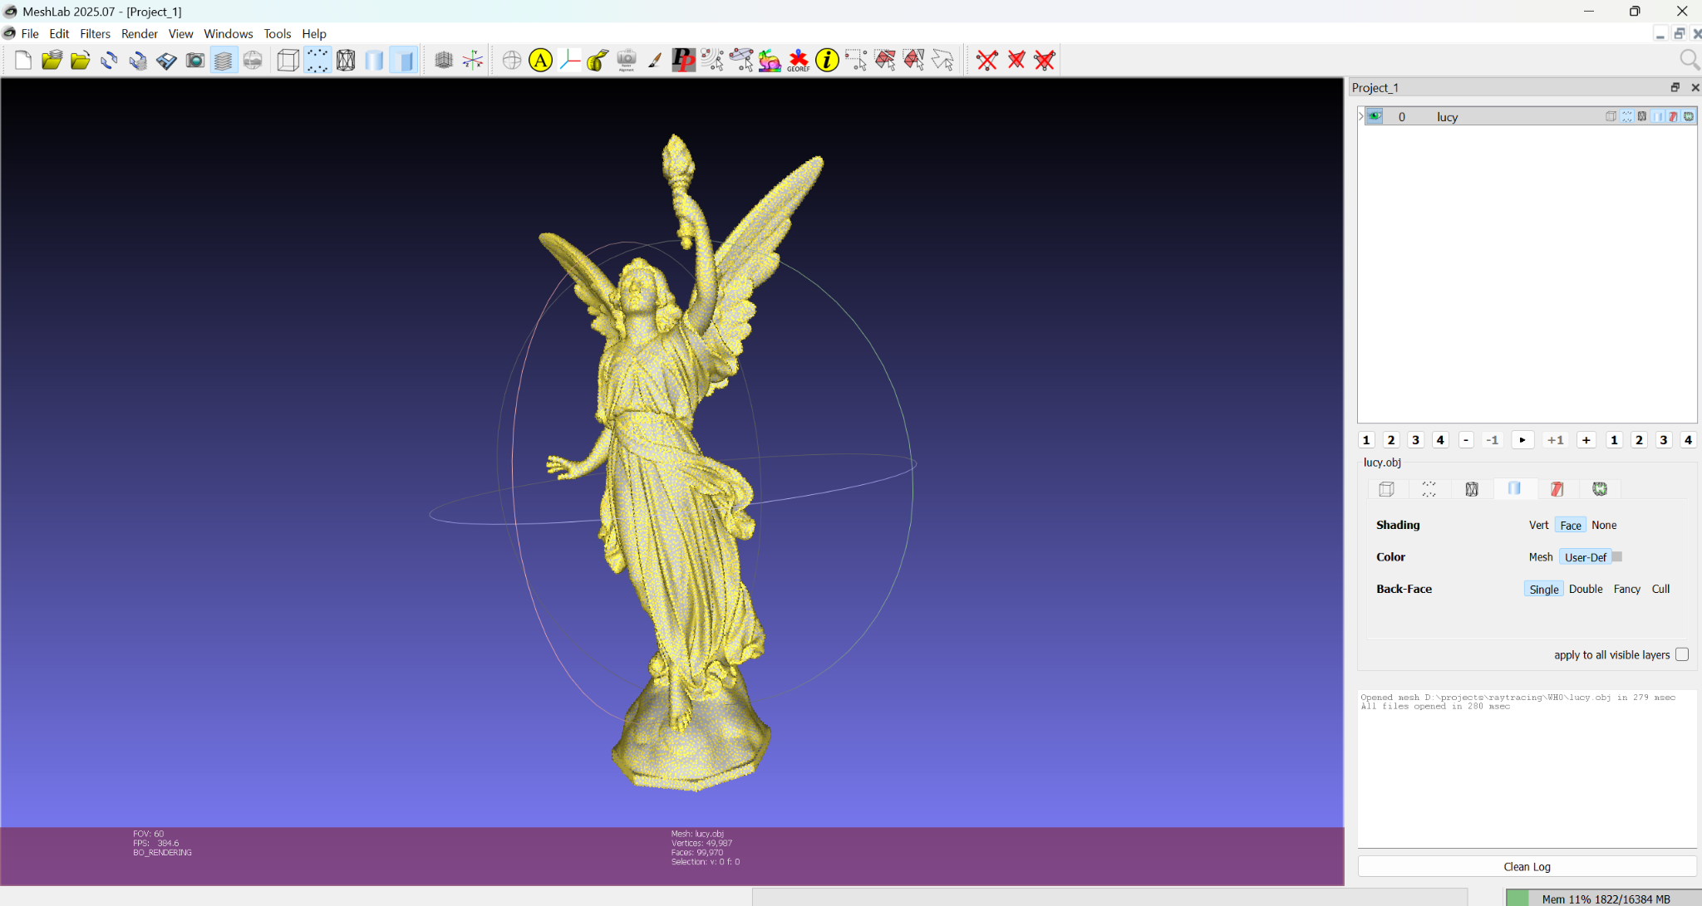
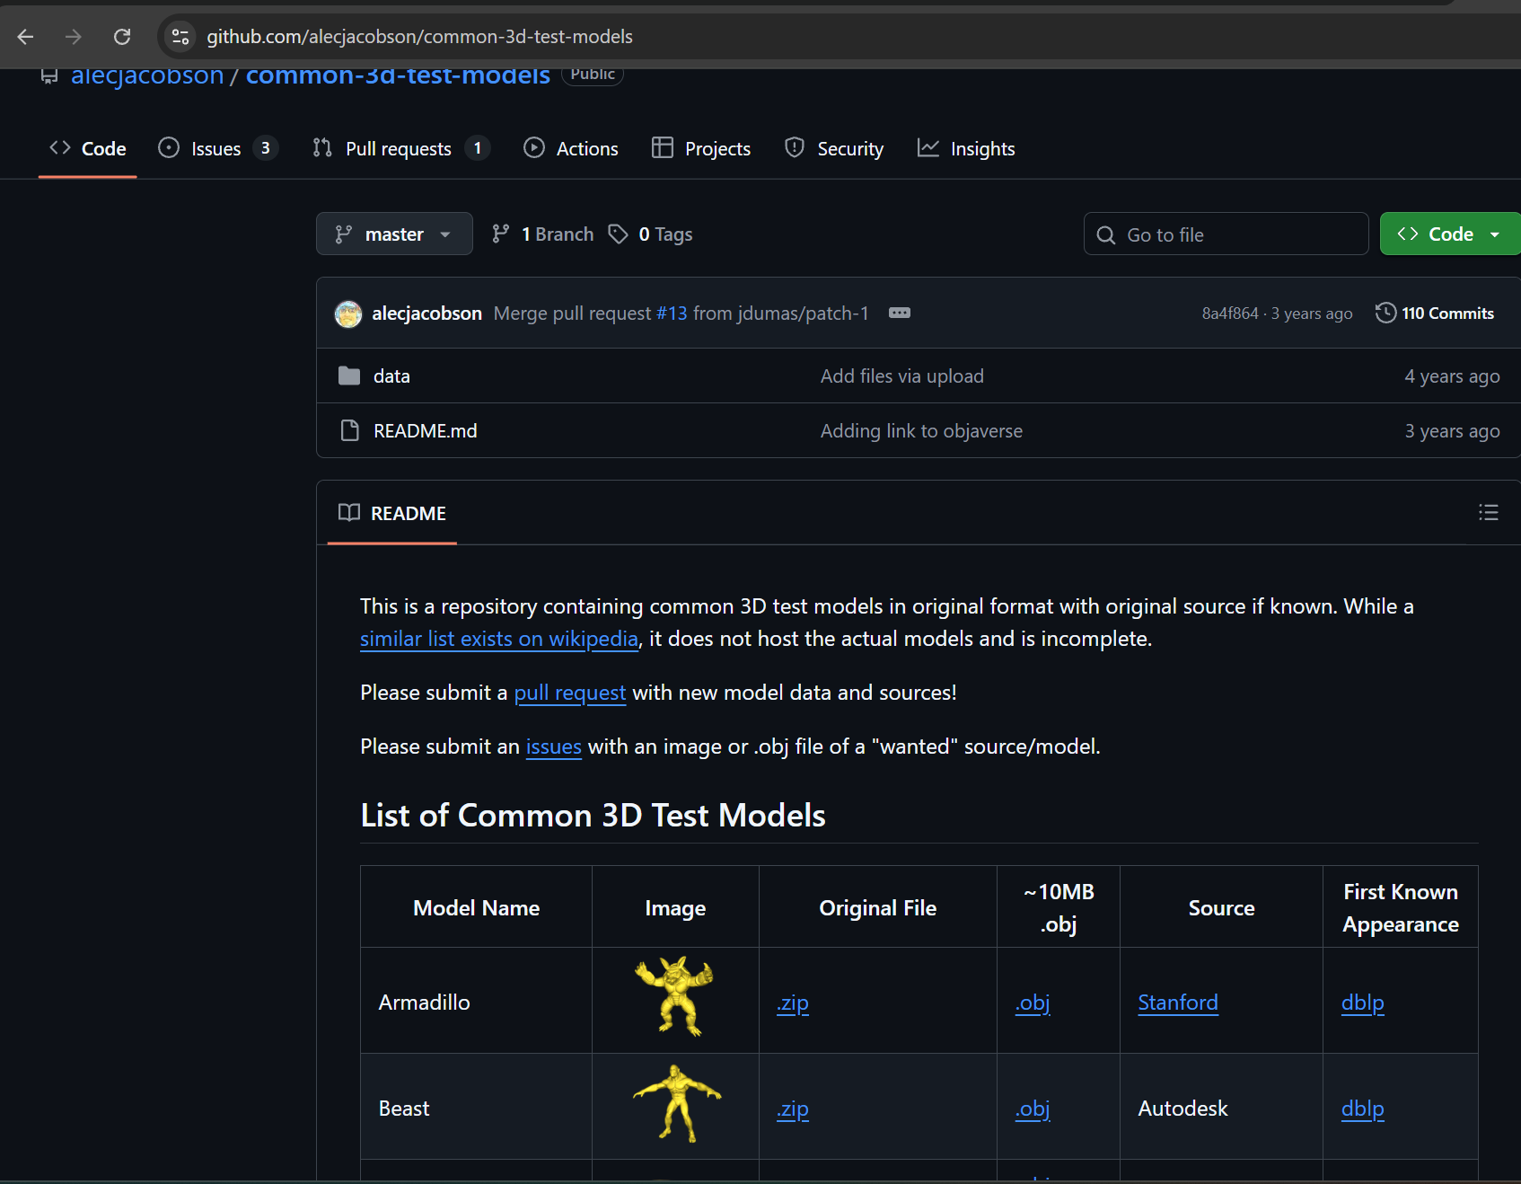
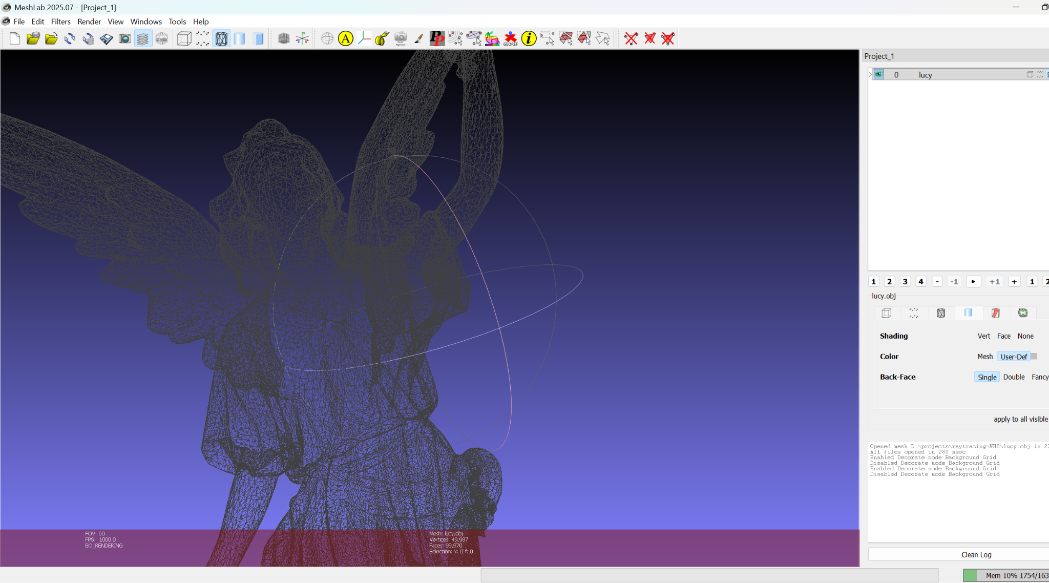
Danyal Khorami
HW0
Standard Computer Graphic 3D models
In computer graphics, Lucy is a world-famous 3D benchmark model representing a Christian angel statue. Scanned by the Stanford University Computer Graphics Laboratory.

